Slide 1
Intro to Single-cell RNA-seq

Slide 2
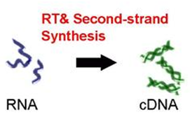
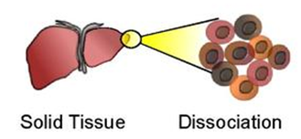
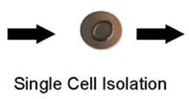
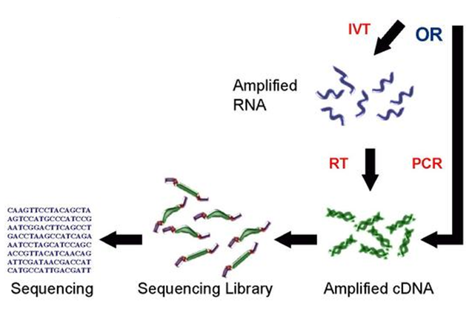
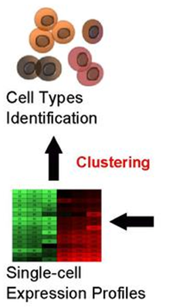
Single-cell RNA-seq pipeline

Slide 3
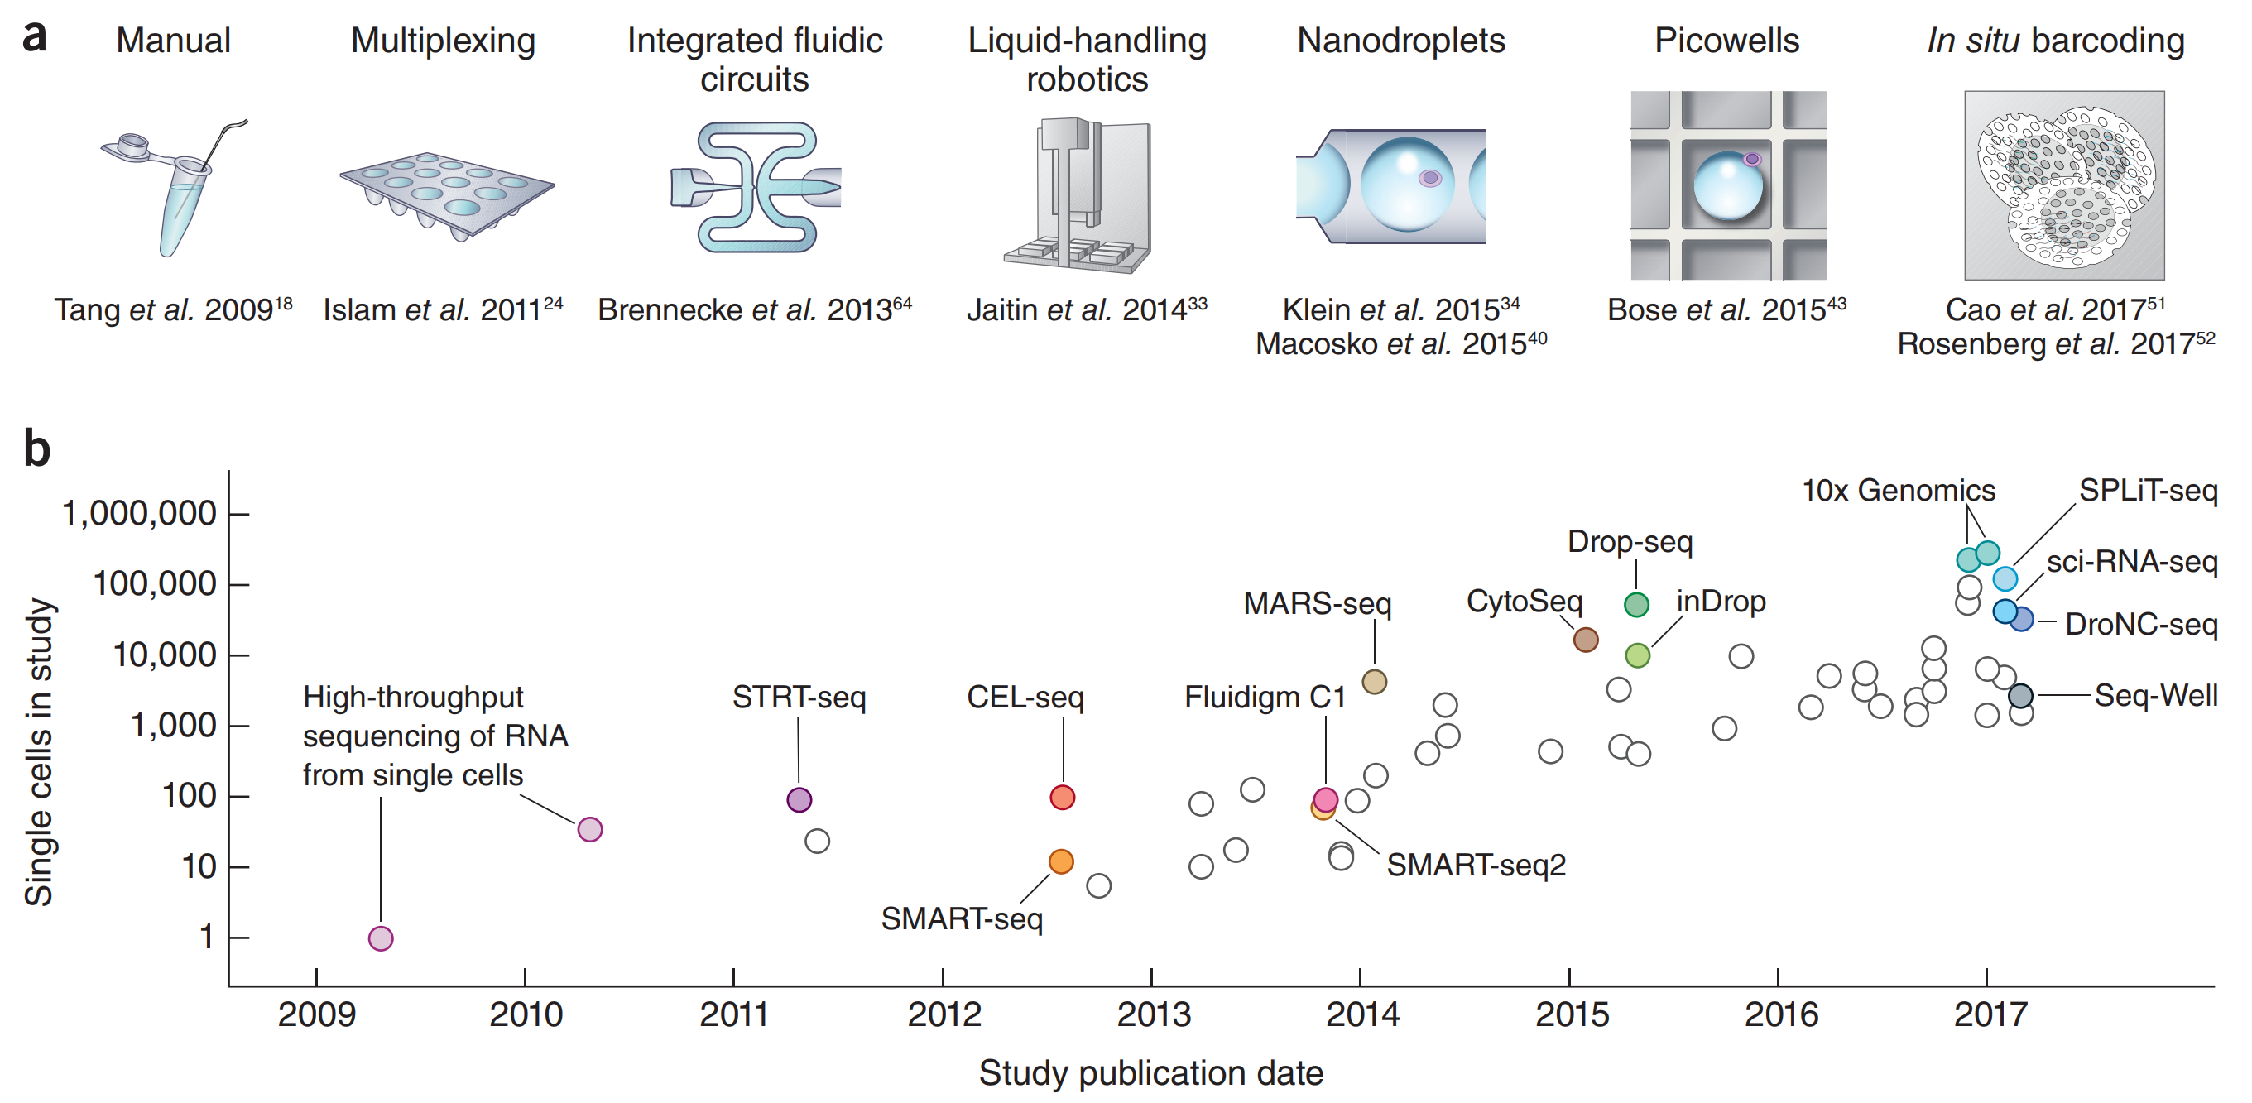
Moore’s law in single cell transcriptomics
Svensson et al. 2018. DOI:10.1038/nprot.2017.149

Slide 4
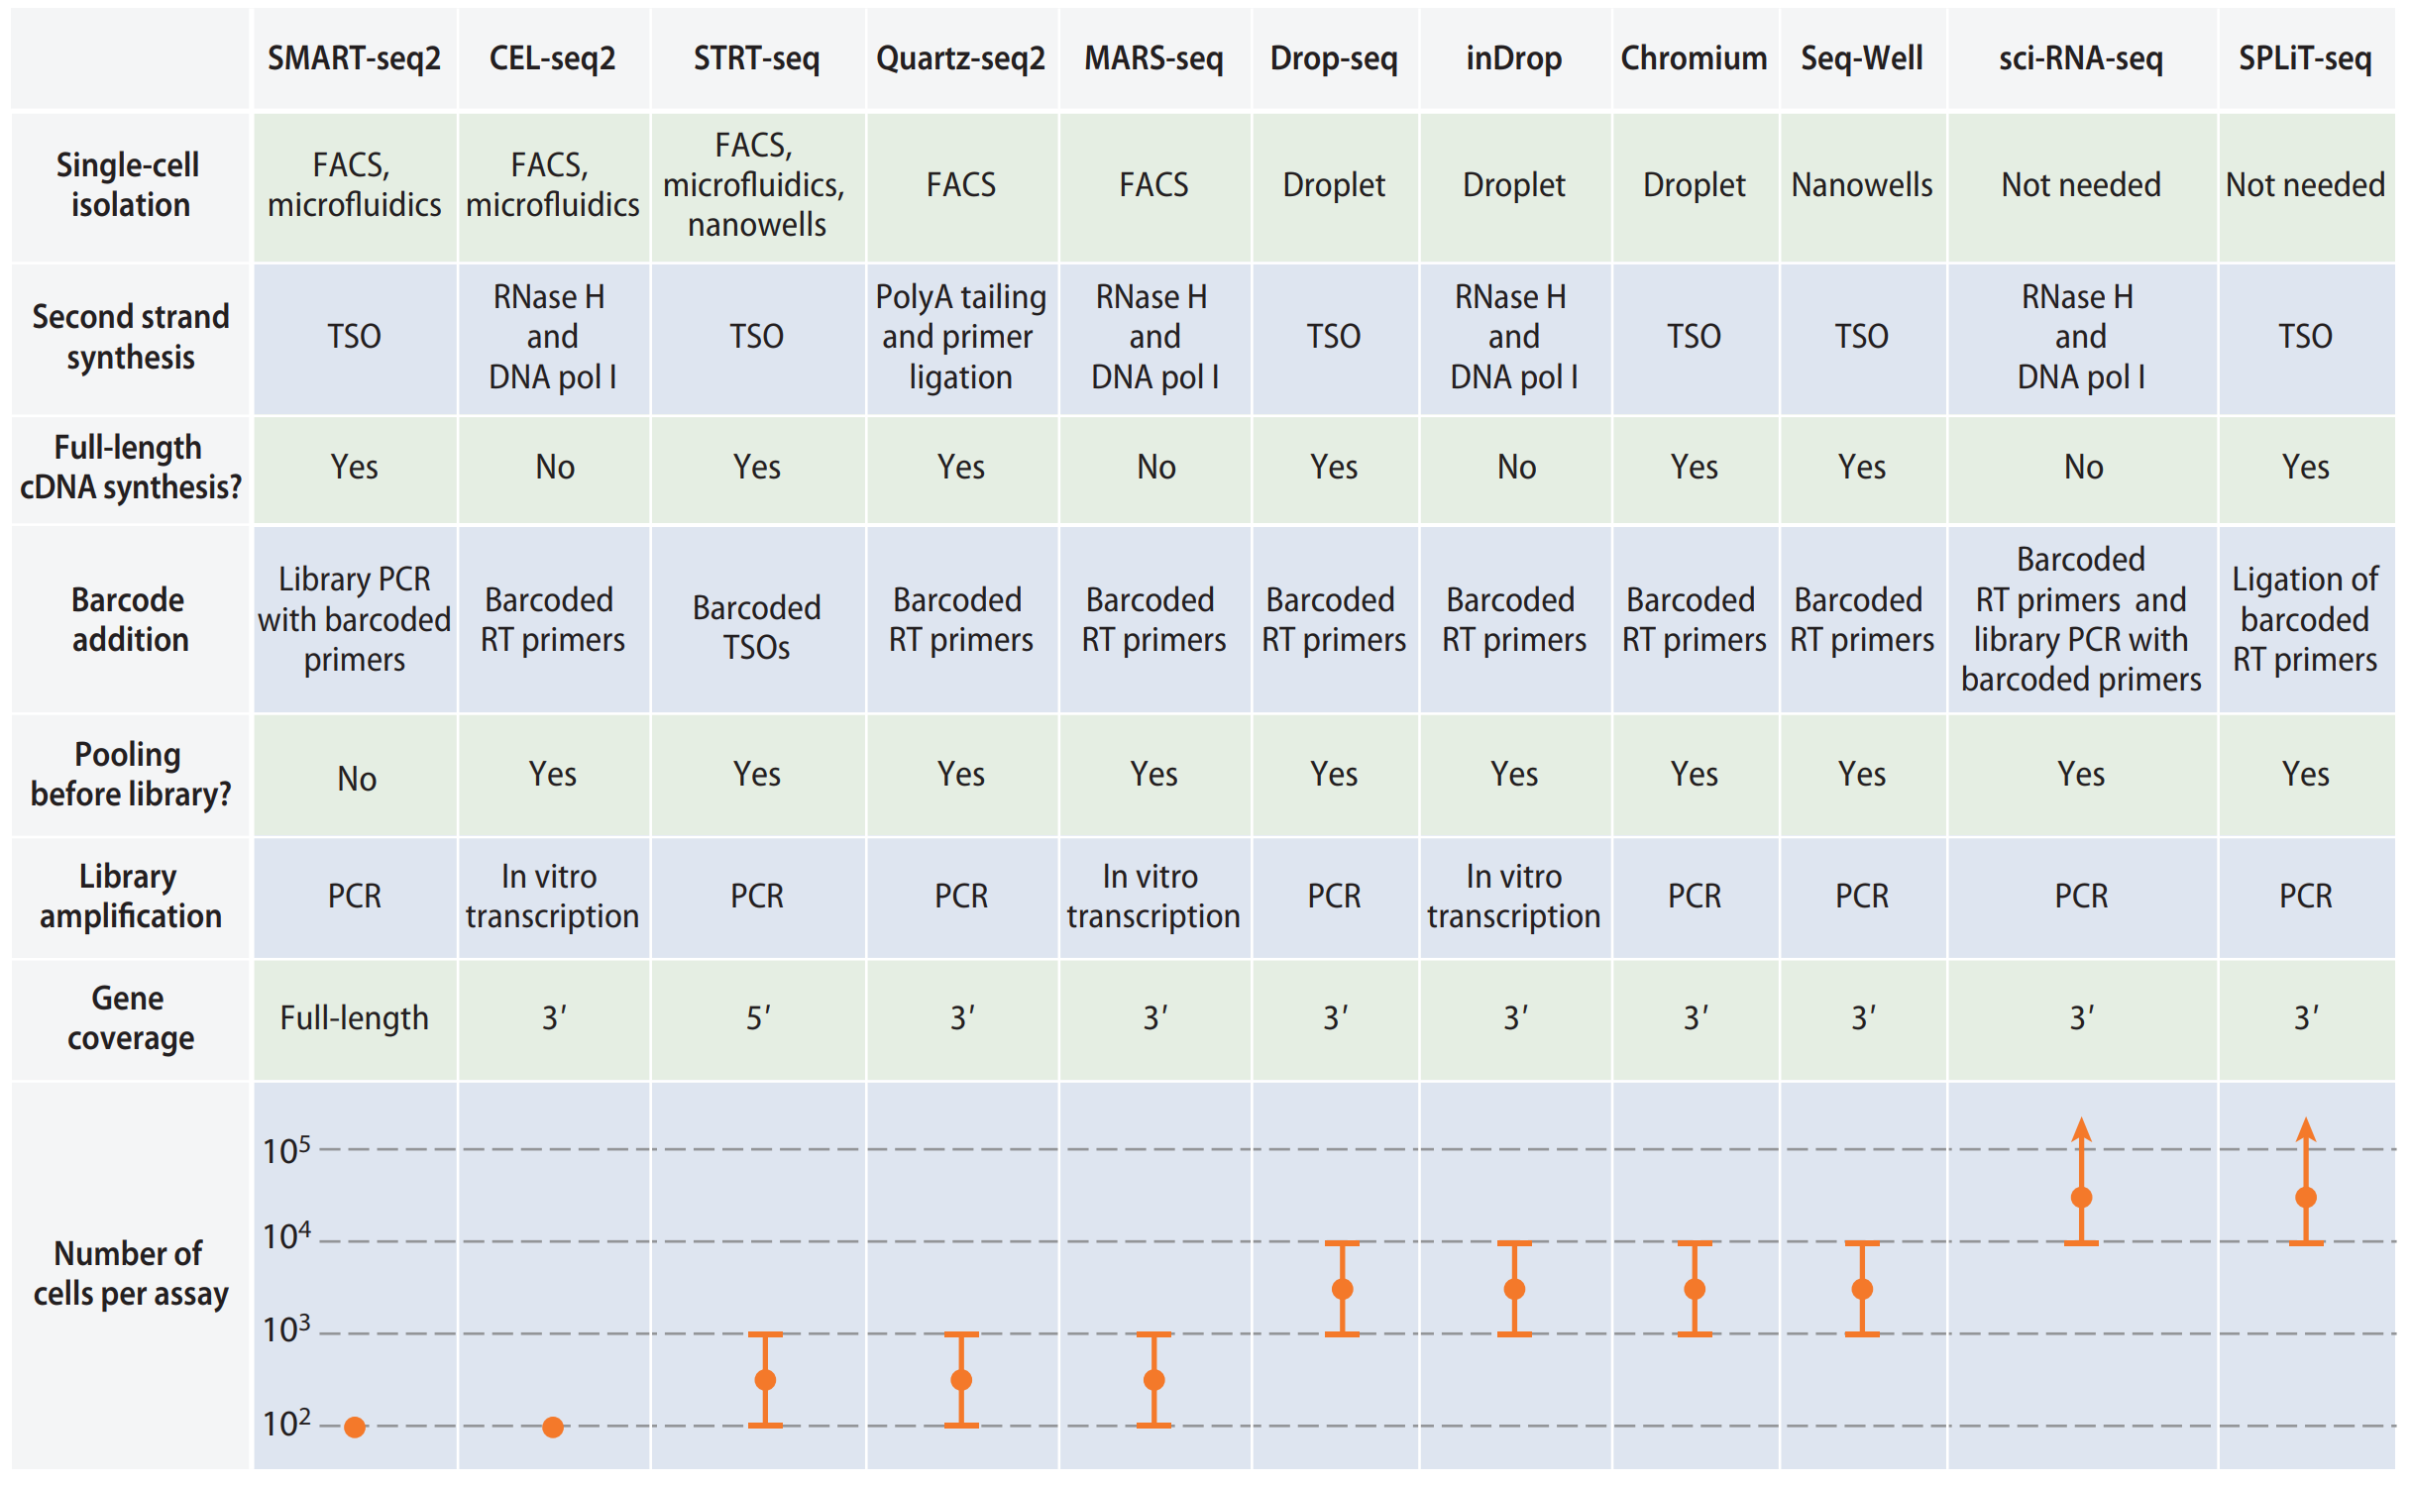
Popular single-cell RNA-seq protocols
Chen et al. 2018. DOI:10.1146/annurev-biodatasci-080917-013452

Slide 5
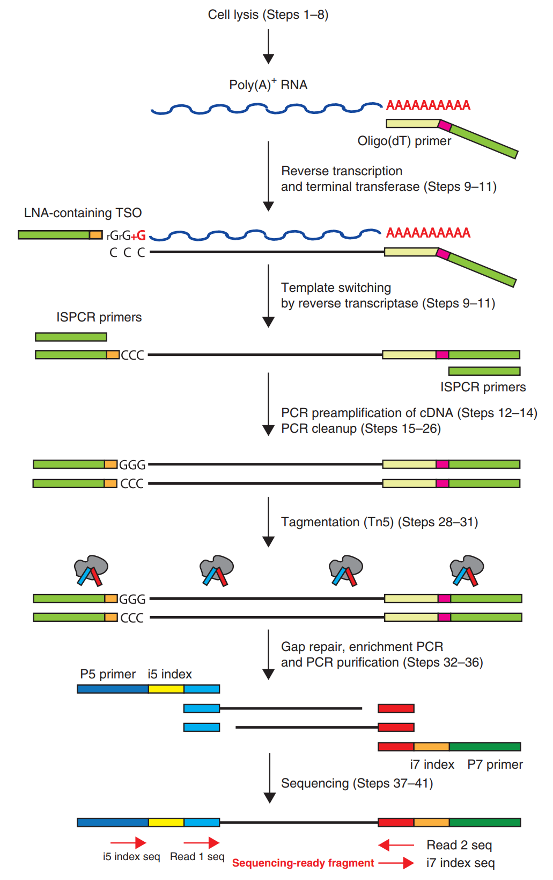
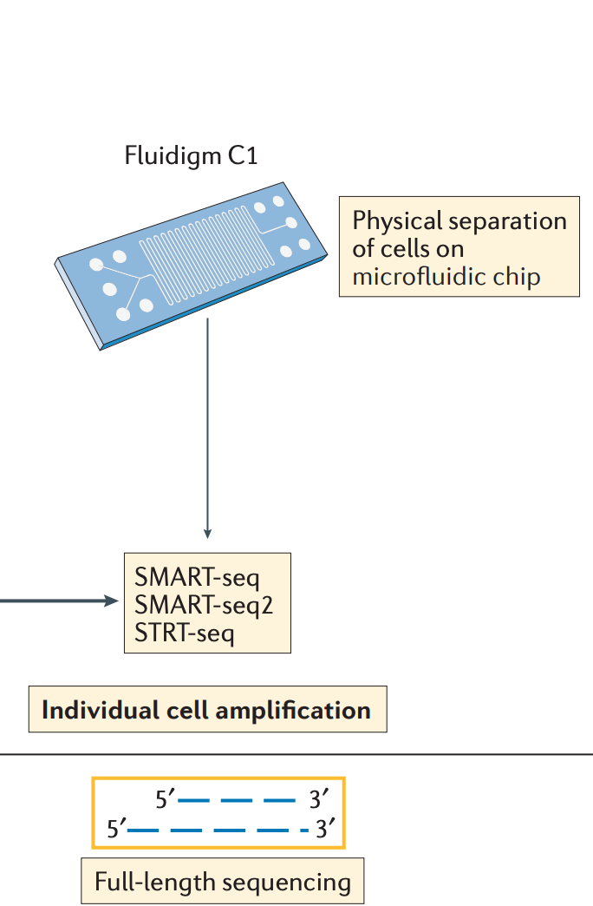
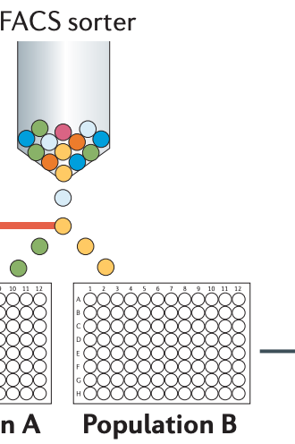
Separation of cells in wells
Papalexi and Satija, 2017. DOI:10.1038/nri.2017.76
Picelli et al., 2014. DOI:10.1038/nri.2017.76

Slide 6
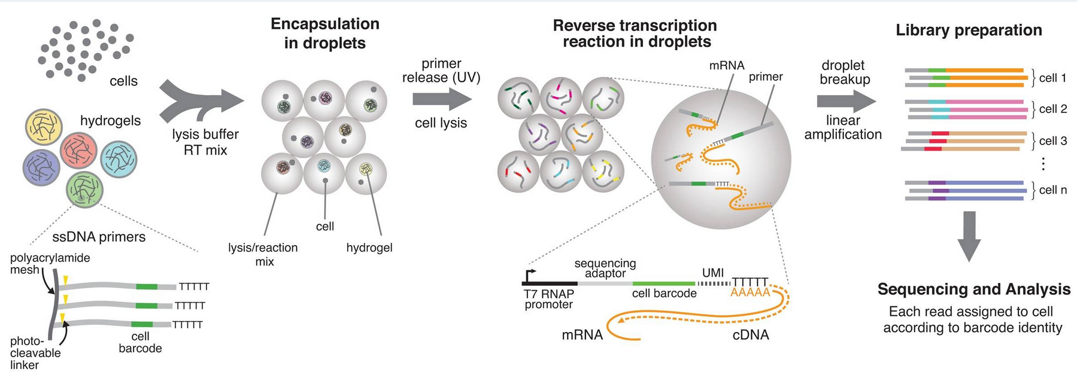
Drop-Seq
Macosko et al. 2015. DOI: 10.1016/j.cell.2015.05.002

Slide 7

Droplet based approach

Slide 8
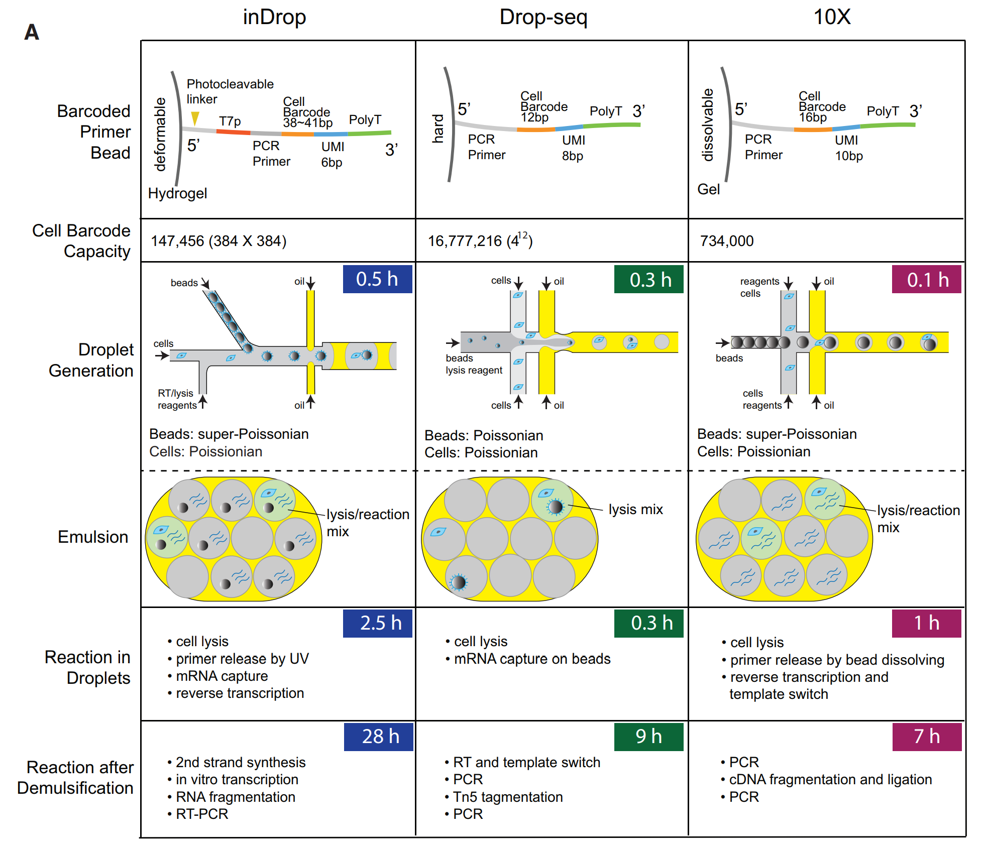
Zhang et al. 2019. DOI:10.1016/j.molcel.2018.10.020

Slide 9
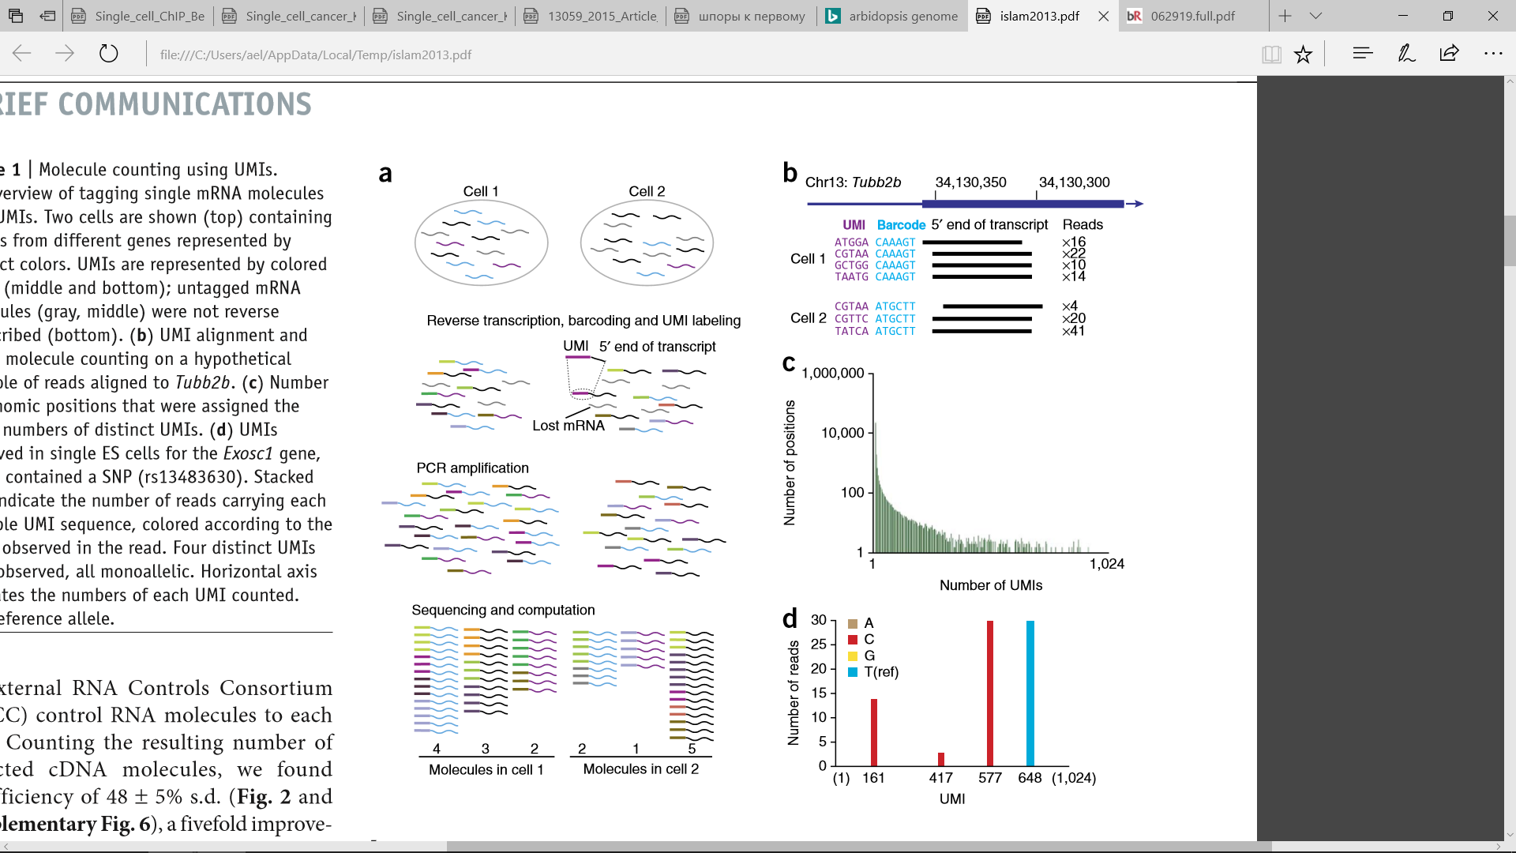
UMIs

Slide 10
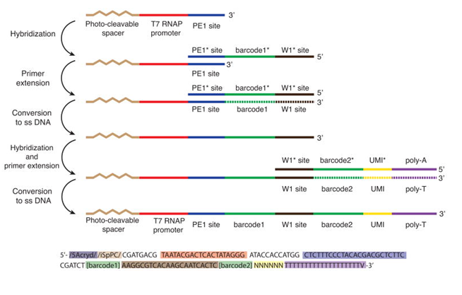
Reads processing
Droplets barcoding + UMI
Read QC & Trimming
Mapping
Quantification

Slide 11
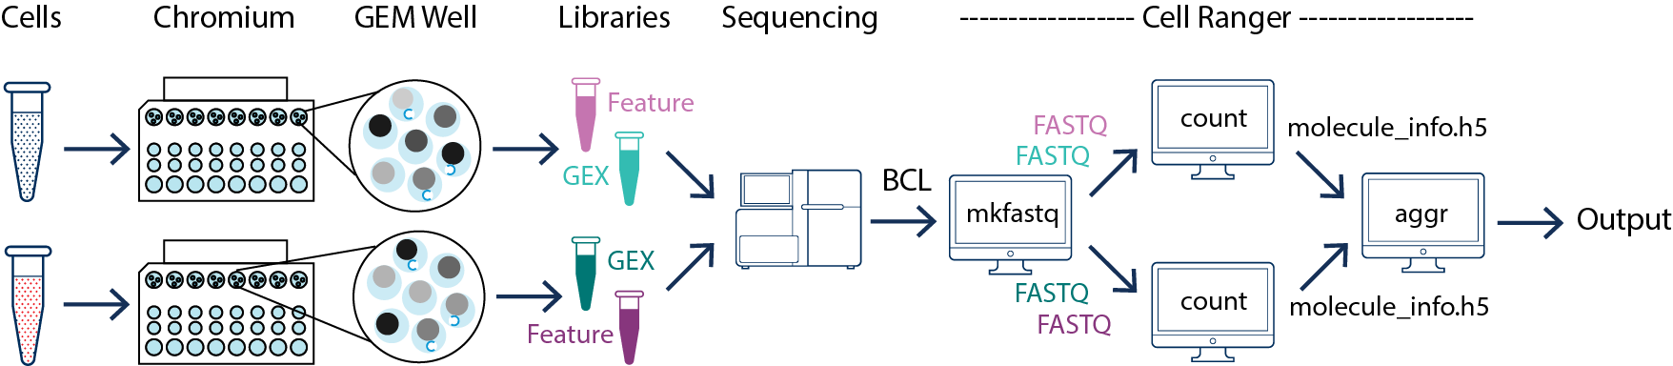
Most popular protocol nowadays: 10x genomics

Slide 12
Expression Analysis
Two popular frameworks:
Seurat
Scanpy
Cell QC + Normalization
Subpopulations discovery
Differential expression

Slide 13
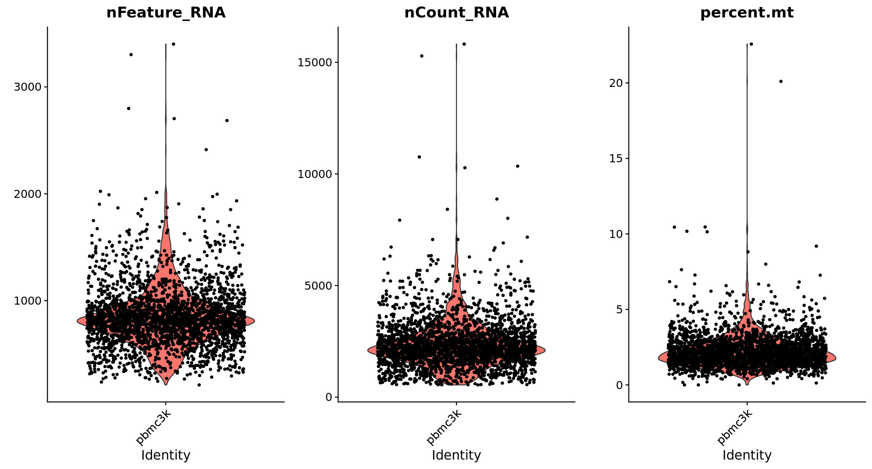
Cell QC + Normalization

Slide 14
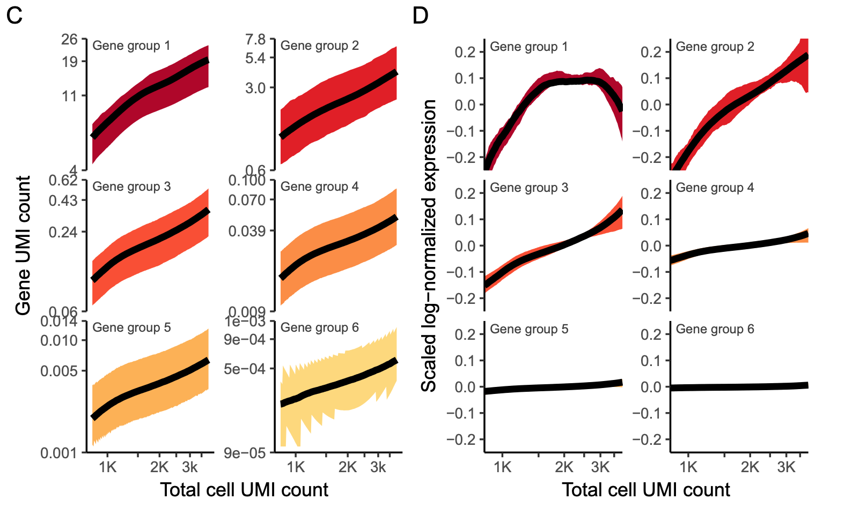
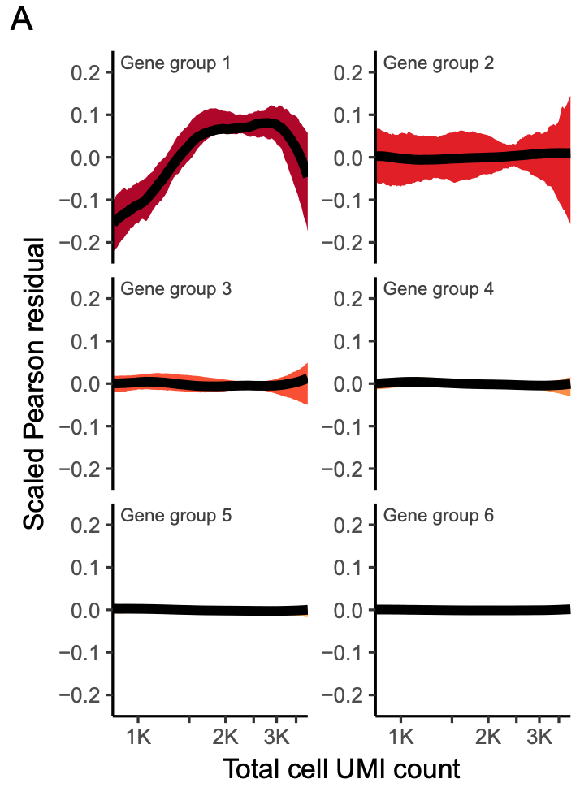
Cell QC + Normalization
Default LogNormalizion – Division by total expression and log transformation
Fitting regression models for each gene individually and use residuals from this model as normalized expression levels
DOI: 10.1101/576827

Slide 15
Subpopulations discovery
Perform linear dimensional reduction (PCA)
Run non-linear dimensional reduction (UMAP/tSNE)
Cluster the cells (construct a KNN graph based on the euclidean distance in PCA space)

Slide 16
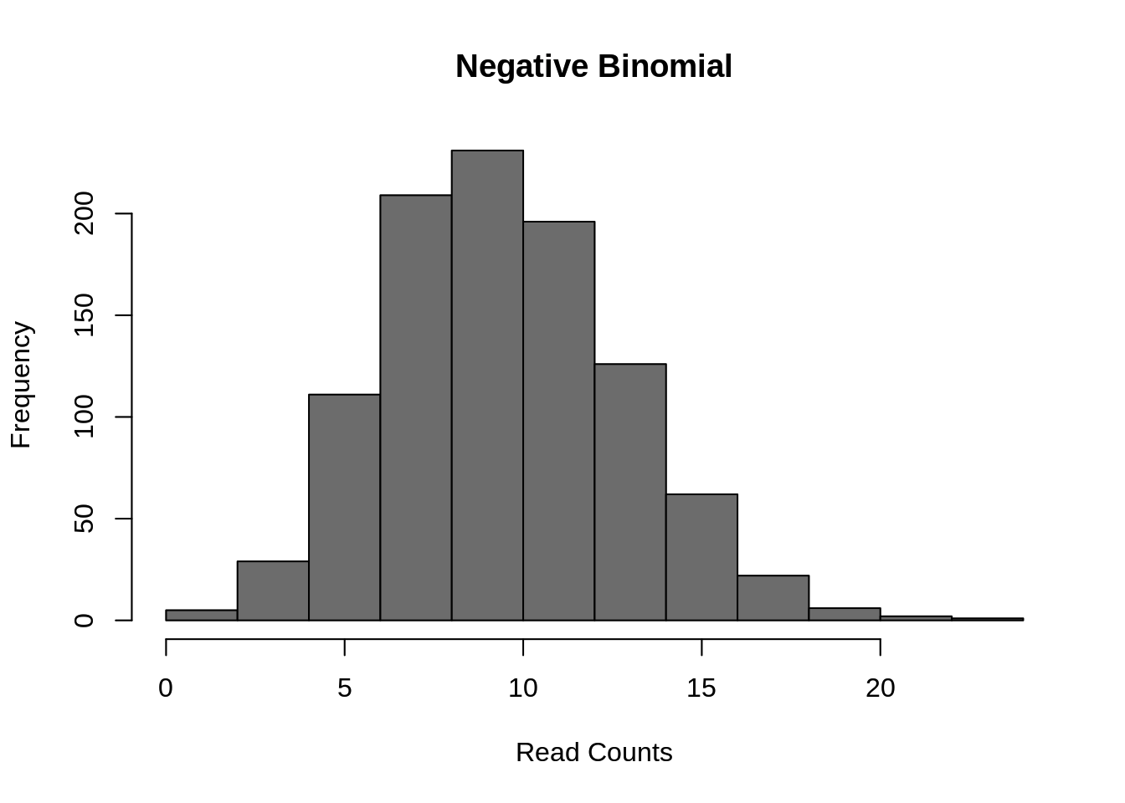
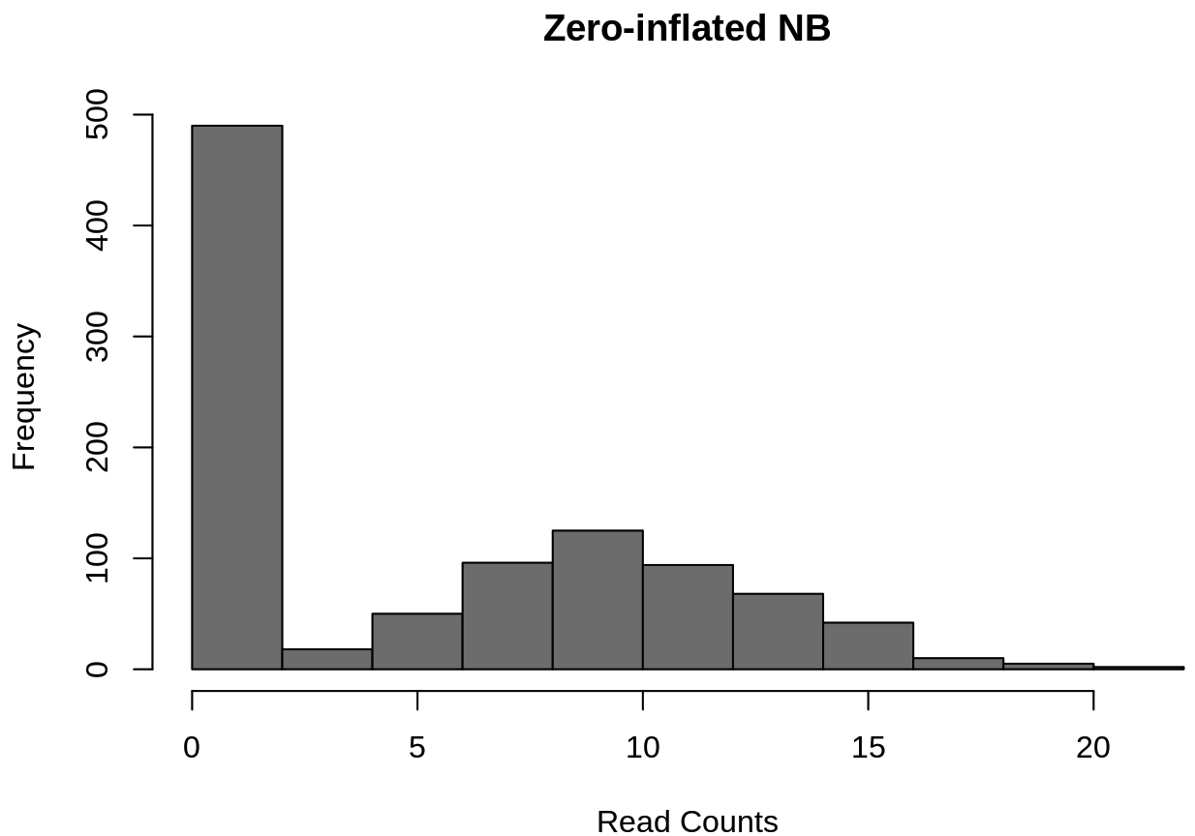
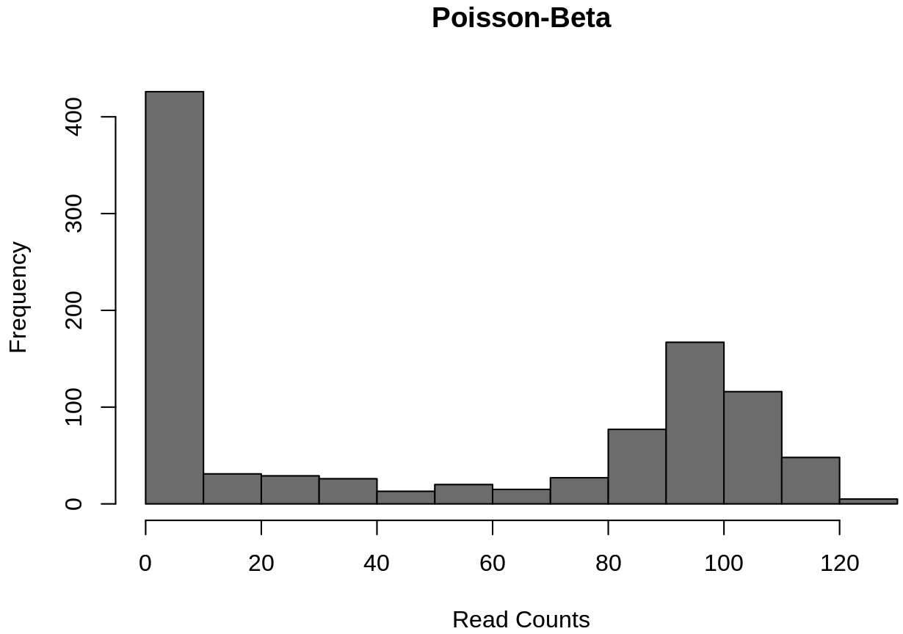
Differential expression
Negative binomial distribution (e.g. edgeR, DESeq2)
Zero-inflated negative binomial models (e.g. MAST, SCDE).
Poisson-Beta distribution (BPSC)

Slide 17
Biological Interpretation
Open Question
Cellular dynamics analysisSaelens et al. 2019. DOI:10.1038/s41587-019-0071-9
Linear methods
Tree methods:
Monocle - Qiu et al. 2017. DOI:10.1038/nmeth.4402
Graph methods:
PAGA - Wolf et al. 2019. DOI:10.1186/s13059-019-1663-x
Monocle3 - manual

Slide 18
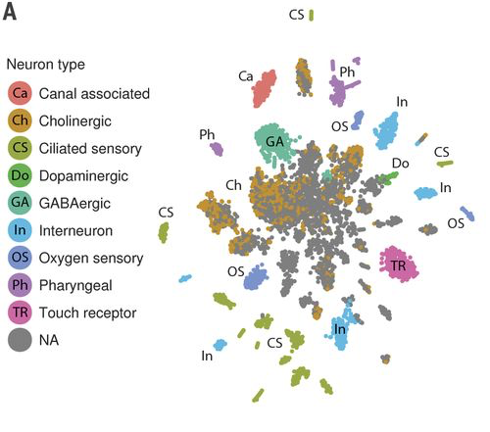
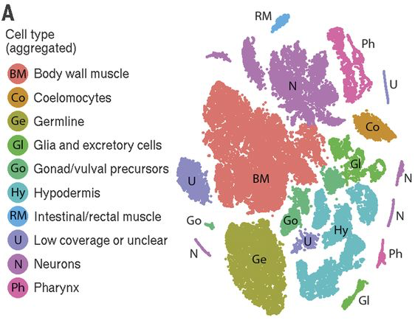
scRNA-seq of the C. elegans
Cao et al. 2017. DOI:10.1126/science.aam8940

Slide 19
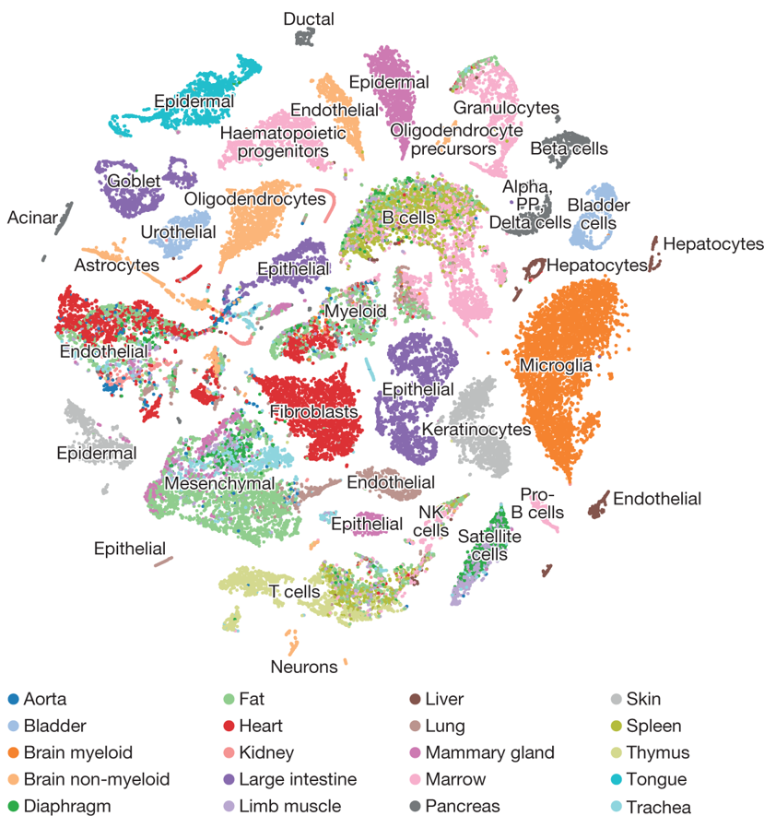
scRNA-seq of mouse
DOI: 10.1038/s41586-018-0590-4

Slide 20
Interesting examples
SCVI (Lopez et al. 2008. DOI: 10.1038/s41592-018-0229-2)
Trash in, not always trash out
RNA Velocity (La Manno et al. 2018. DOI:10.1038/s41586-018-0414-6)
Mitochondrial lineage tracing (Ludwig et al. 2019. DOI:10.1016/j.cell.2019.01.022)

Slide 21
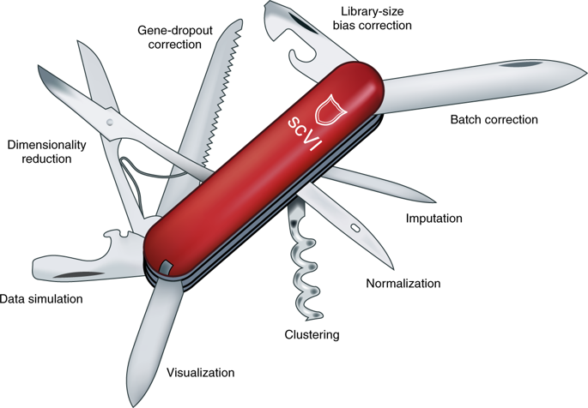
SCVI
Lopez et al. 2008. DOI: 10.1038/s41592-018-0229-2

Slide 22
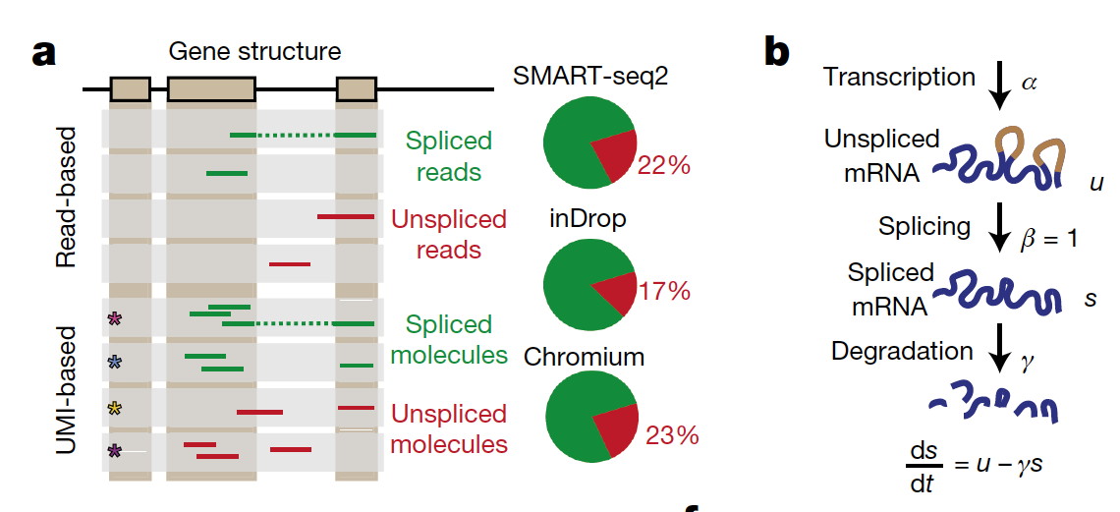
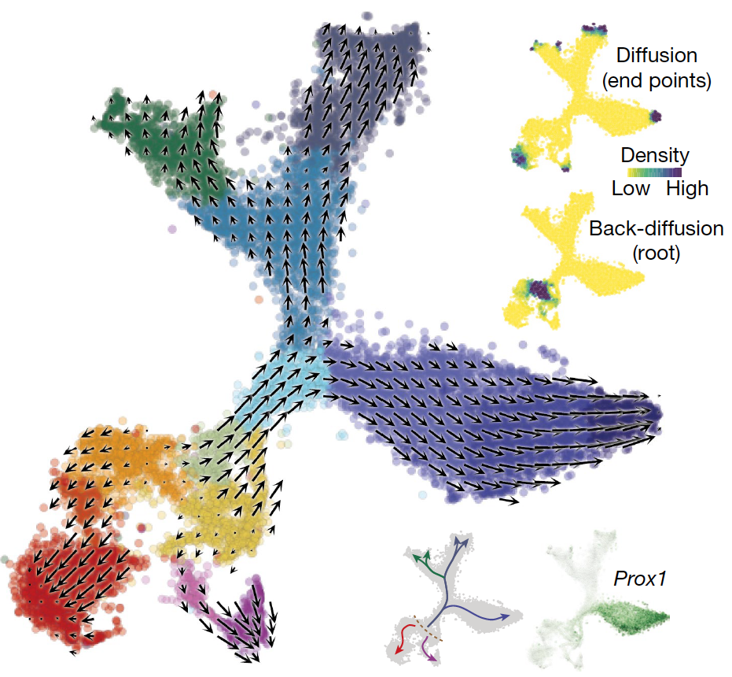
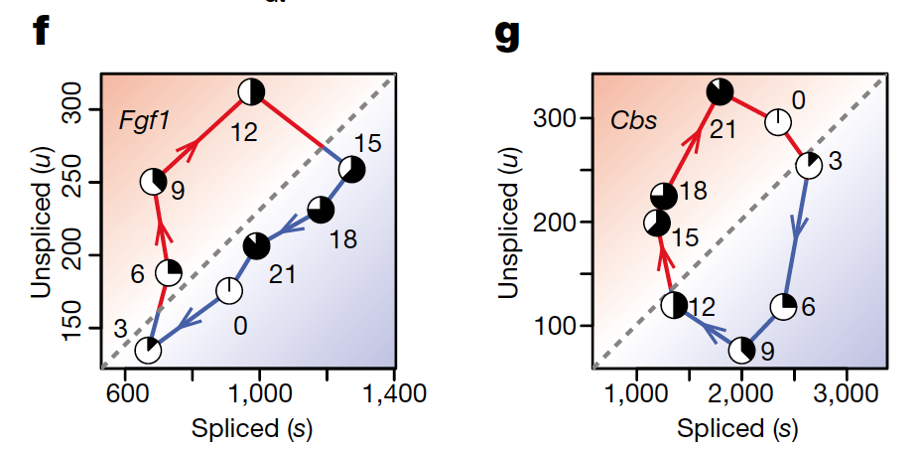
RNA Velocity
La Manno et al. 2018. DOI:10.1038/s41586-018-0414-6

Slide 23
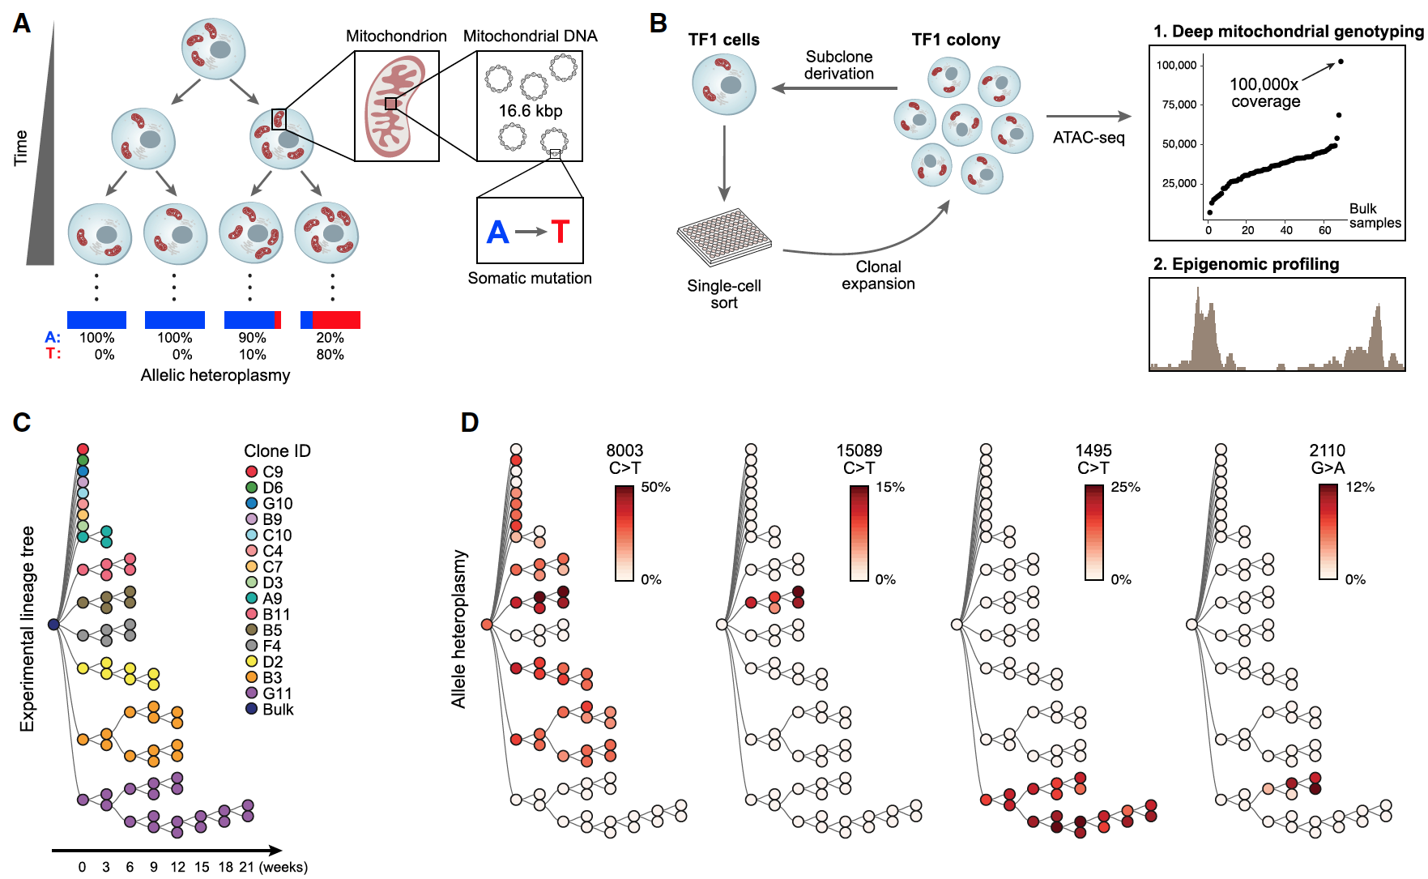
Mitochondrial lineage tracing
Ludwig et al. 2019. DOI:10.1016/j.cell.2019.01.022

Slide 24


Get started with scRNA-seq
Analysis of single cell RNA-seq data course
Bioarxiv
Twitter

Slide 25
Assignment
Start with preprocess matrix (no need to do read preprocessing)
Perform Expression analysis and interpret the results

Slide 26
Loading data
library(Seurat)
library(velocyto.R)
library(SeuratWrappers)
library(ggplot2)
library(cowplot)
library(gridExtra)
library(monocle3)
load(file = "hse.object.Rdata")
#sc.object – default Seurat object with which you will be working
#cds.graph – cell_data_set object for monocle3
#bm.integ – Seurat object with stored spliced and unspliced information for RNA velocity
data <- sc.object

Slide 27
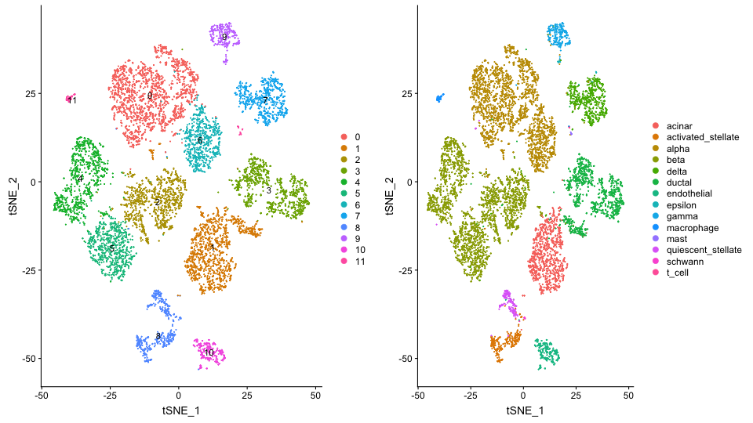
Subpopulations discovery
data <- RunPCA(object = data, verbose = FALSE)
data <- RunTSNE(object = data , dims = 1:30, verbose = FALSE)
data <- FindNeighbors(object = data , dims = 1:30, verbose = FALSE)
data <- FindClusters(object = data , resolution=0.2, verbose = FALSE)
DimPlot(object = data, label = TRUE)

Slide 28
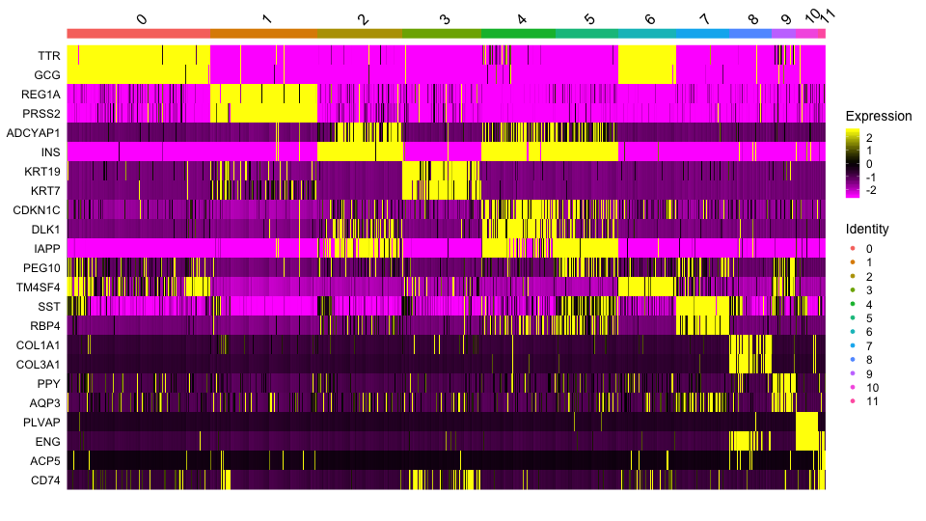
Differential expression
pbmc.markers.cell <- FindAllMarkers(object = data, only.pos = TRUE, min.pct = 0.5, logfc.threshold = 0.2)
top2 <- pbmc.markers.cell %>% group_by(cluster) %>% top_n(n = 2, wt = avg_logFC)
DoHeatmap(object = data, features = top2$gene)

Slide 29
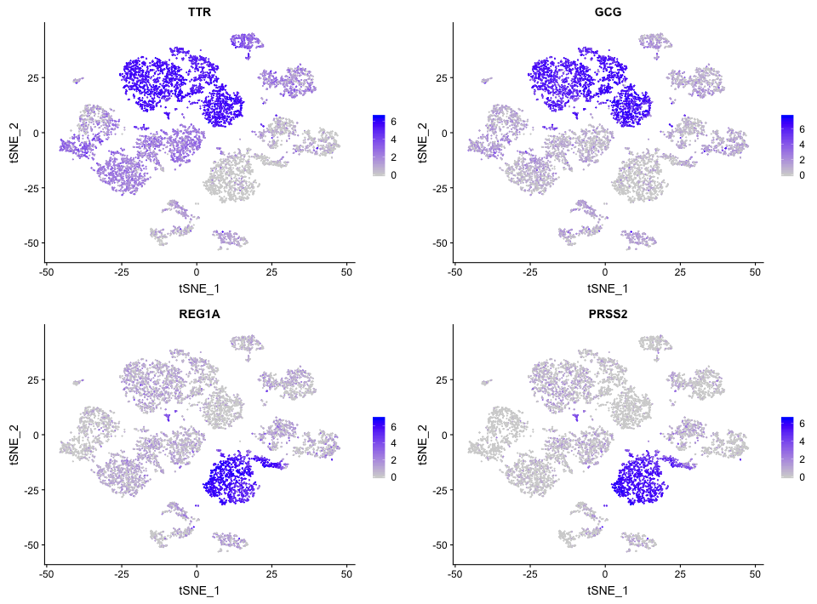
Investigating markers
FeaturePlot(object = data,
features = c("IRF8", "CD74", "BATF3", "SPI1"),
pt.size = 0.2, ncol = 2)

Slide 30
Report
1 November - “scRNA-seq task” - i.y.kurochkin@gmail.com
Discover subpopulation (using different parameters) and compare to cell types stored in field “cells”
Perform DE of clustering results and “cells”
Investigate those markers and get some biological ideas (e.g. GO enrichment)
Select single cell article and describe protocol, computational methods used. What are pros/cons?

Slide 31
Advanced task (***)
Perform analysis of pseudotime trajectory in monocle3 and report genes that changes along trajectory – Monocle3 manual (using cds.graph object)
Perform analysis of cellular dynamics using RNA velocity – manual embedded into Seurat (using bm.integ object)
Try to reproduce all the analysis in Scanpy (using conversion of Seurat object into loom files)

